Slide 1

Salifort Motors’ Employee Retention Project
Part of Google Advanced Data Analytics Certification

Slide 2
What factors are likely to make the employee leave the company?

Slide 3
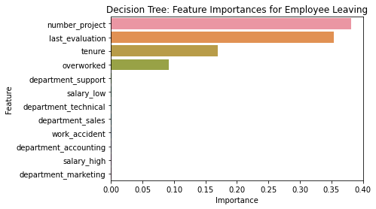
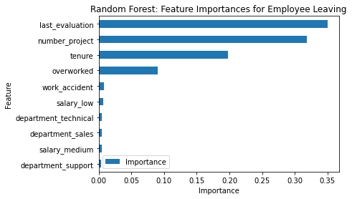
The random forest model slightly outperforms the decision tree model
Decision tree model’s most relevant variables: ‘last_evaluation’, ‘number_project’, ‘tenure’ and ‘overworked’
Random forest model’s most relevant variables:
`last_evaluation`, `tenure`, `number_project`, `overworked`, `salary_low`, and `work_accident`

Slide 4

INSIGHTS
Cap the number of projects that employees can work on.
Consider promoting employees who have been with the company for at least four years, or conduct further investigation about why four-year tenured employees are so dissatisfied.
Either reward employees for working longer hours, or don't require them to do so..
Hold discussions to understand and address the company work culture, across the board and in specific contexts.
Consider a proportionate scale for rewarding employees who contribute more/put in more effort

